Slide 1
TYPES OF LISTENING

Slide 2
What is listening ?
Listening is the ability to accurately receive and interpret messages in the communication process. Listening is key to all effective communication. Without the ability to listen effectively, messages are easily misunderstood.
Notes:
Carefully listening , make an effort to hear something , being alert and attentive.

Slide 3
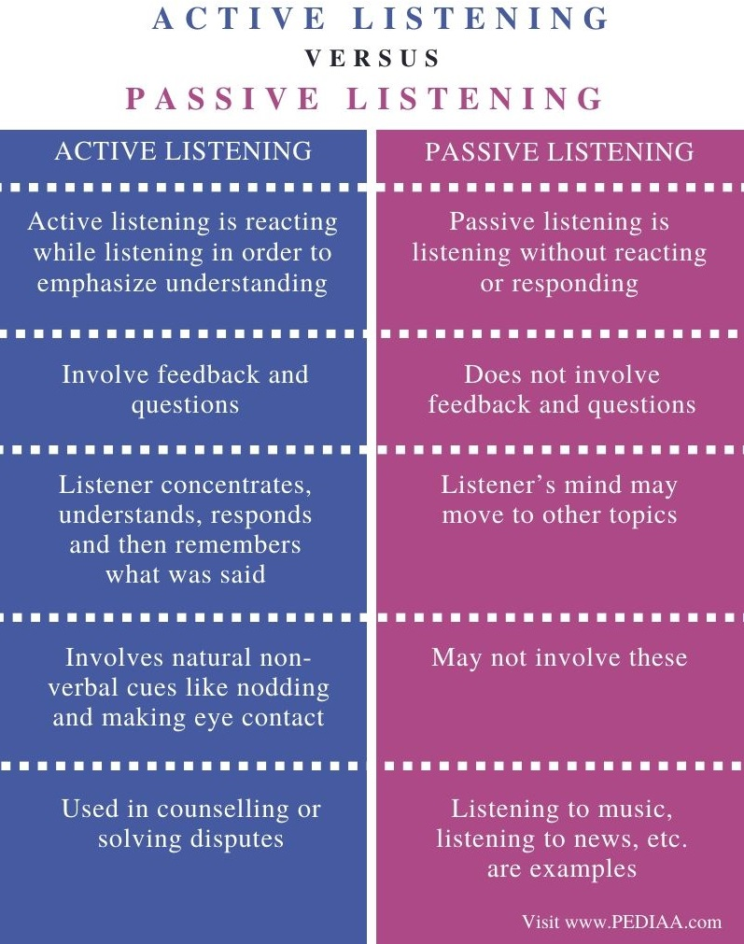

Slide 4
Types of listening
Informational listening.
Discriminative listening.
Biased listening.
Sympathetic listening.
Empathetic or therapeutic listening.
Effective listening .
Critical listening.

Slide 5
Informational listening
Paying attention to the information being conveyed by the speaker.
listening with the goal of comprehending and retaining information.
Notes:
Listening with the goal of learning understanding and grasping info EXAMPLE : NEWS CHANNELS DADS

Slide 6
Discriminative listening
Discriminative listening is when the listener interprets and assigns meaning to sound rather than to words.
The listener focuses on characteristics such as speed, intonation and pitch.

Slide 7
Biased listening
Biased listening is also known as selective listening.
Someone who uses biased listening will only listen for information that they specifically want to hear.

Slide 8
Sympathetic listening
Shows the caring attitude of the listener.
This type of listening occurs amongst close friends or relatives.
Notes:
Understanding the feelings of the speaker….

Slide 9
Empathetic or therapeutic listening
Empathic listening is the practice of being attentive and responsive to other’s input during conversation.
Similar to sympathetic listening but the listener not only listens but experiences the feelings of the speaker themselves.

Slide 10
Effective listening
Actively absorbing the information given to you by the speaker.
Showing that you are listening and interested.
Providing feedback to the speaker so that he/she knows the message was received.

Slide 11
Critical listening
Judgemental in nature.
Understanding what is said and evaluating, judging and forming an opinion.
Good for business.

Slide 12
Thank you..!!

